Slide 1
Earth, Wind, Fire, Water, Sky: Climate Transformed
Artists working with subjects of climate change

Slide 2
Premise of this exhibition
Fifteen Artists explore the human relationship to the landscape and nature made evident through agricultural use, migration, habitat change, warming temperatures, wildfire, drought and heavy rains. The work beckons the viewer to reflect upon not only the beauty of the natural world but also question our commitment to sustainability and to a reciprocal relationship which strengthens the exchange of resources and knowledge. The exhibit includes multiple perspectives asking viewers to participate as better global citizens, as well as offering resilience and hope to strengthen their bond with the earth at this crucial point in history.

Slide 3
Christine Buth Furness
I Carry Two Landscapes With Me Wherever I Go is an image divided in half with the left side suggesting a cascade of water falling and the right side representing a moonlit sky above a receding lake bed.
The experience of living in and observing two ever changing landscapes is a personal journey taken with the goal of becoming a better citizen in the natural environment.

Slide 4
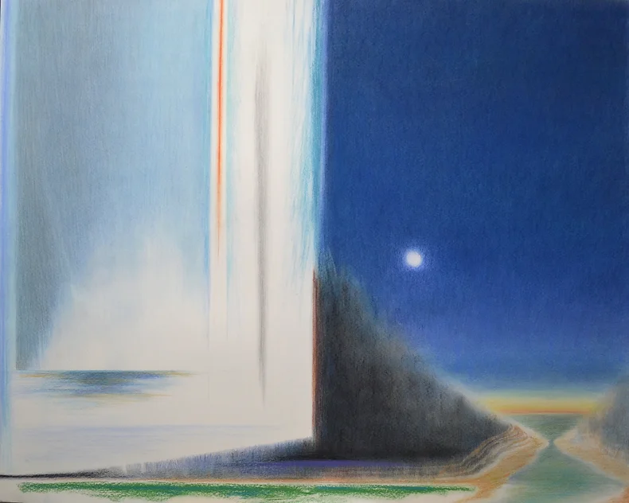
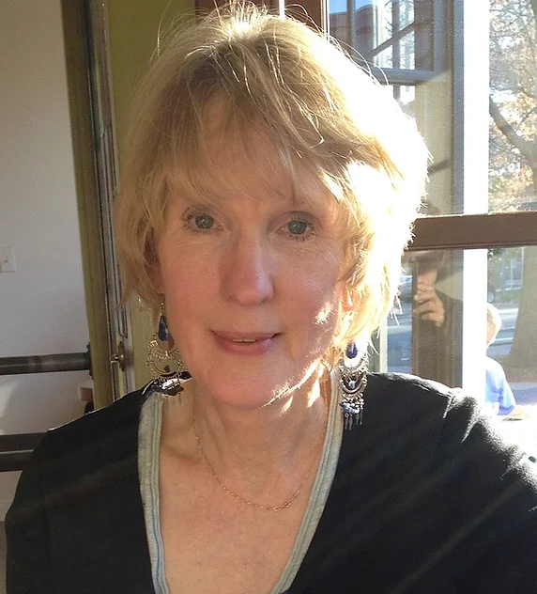
Christine Buth-Furness, Artist/curator
Notes:
Title: I Carry Two Landscapes With Me Wherever I Go. Watercolor.
“I Carry Two Landscapes With Me Wherever I Go” is an image divided in half with the left side suggesting a cascade of water falling and the right side representing a moonlit sky above a receding lake bed. The experience of living in and observing two ever changing landscapes is a personal journey taken with the goal of becoming a better citizen in the natural environment. My paintings and drawings suggest a human presence in an environment and evoke an emotional response. They are abstracted portraits of places experienced, spaces navigated and those imagined.

Slide 5
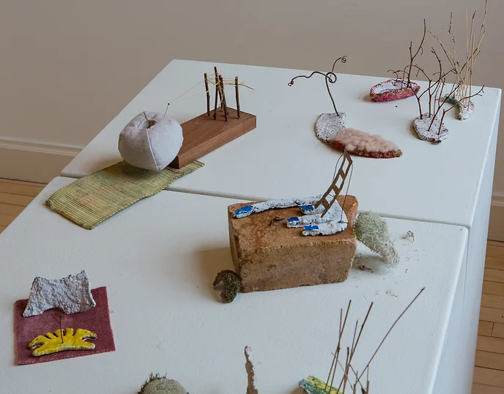
Hannah O’Hare Bennet Recede, mixed media
this work focuses on the receding of water and on things that are revealed after the water goes. It’s perfect that I work with handmade paper, using much water before the final product is revealed. I grew up on a Farm in a flood plain, with floods and drought ever present.
Notes:
Hannah was raised on a farm in a flood plain and with that, found drought and flooding were part of her normal cycle of subsistence. Yet, as the challenges of global temperatures warm the planet, the frequency of these occurrences has drawn her into this as a subject of her art.
She works in handmade paper, reliant on water, mixed with a pulp that dries, leaving the remains as the artistic remnants. The things left behind have found parallel in her process and chosen medium as she studies the effects of receding flood waters.

Slide 6
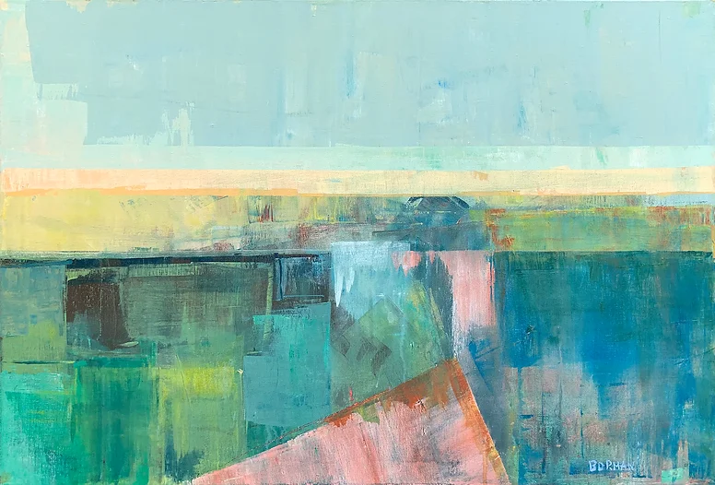
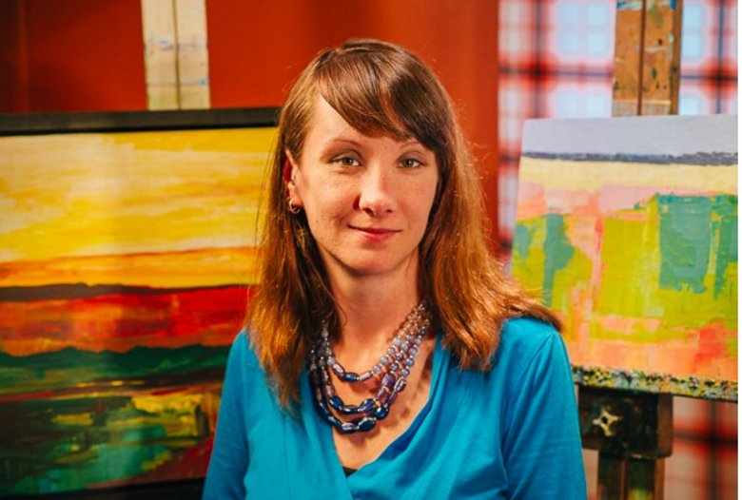
Beki Borman
the landscape is the most accessible subject of the natural world. It has shaped our understanding of visual order. Our ancestors learned to read the landscape for survival, recognizing weather patterns for planting farm fields. I am fascinated by our ever shifting relationship to the horizon: that elusive edge of our planet.

Slide 7
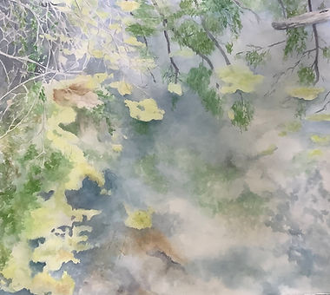
Lois Buley-Wirth
How I pray that the future holds these kind of memories for other children.​
The memories of looking out over clear water
or searching it’s depth.
What peace.
I paint these memories of water.

Slide 8
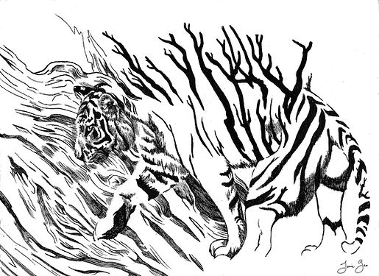
JENIE gAO
Her arts practice is based in printmaking, public art, social practice, and storytelling. She also has a niche consulting in equitable best practices and ethics for cultural organizations and the public sector. She strives to create records and claim space for resilient, diverse stories.

Slide 9
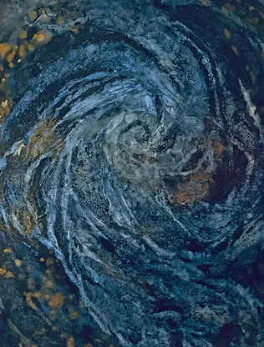
Helen Klebesadel
My paintings examine how in re-claiming, revisioning and remembering ourselves as whole people, we bring our art, our action, and our voices to the world.
We must be able to imagine the world we desire to live within in order to achieve it.

Slide 10
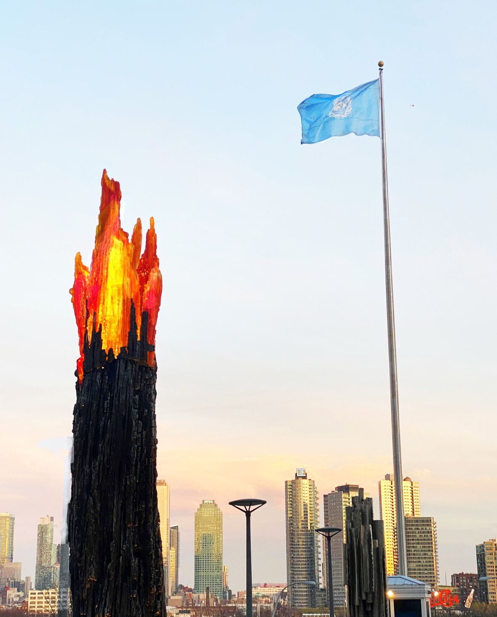
The sculpture evokes the impact of climate change on the environment. It depicts a burning tree that is engulfed in flames. The flames, cast in glass, light up as the sun passes through them and the sculpture illuminates to look like it is on fire. WildFire embodies change and inspires a collective consciousness to move in the direction of a healthy planet.
Natalie Tyler
WildFire, 2022

Slide 11
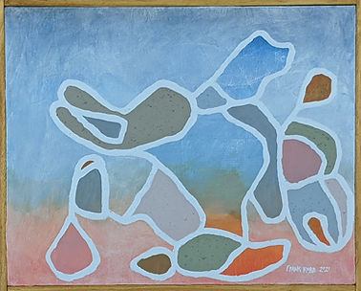
FRANK kORB
These new works all deal with the ideas of climate change. My choices in color use represent the following: the grey represents the ideas (and facts) of pollution: smog, tailpipes, smokestacks, factory exhaust and more. The oranges represent the beautifully rich skies at sunrise and sunset as wildfires across the country and world burn. My choice of the greens represent the pollution of our large and small waterways, rivers, lakes, and oceans. The toned down reds of the burning of cities.

Slide 12
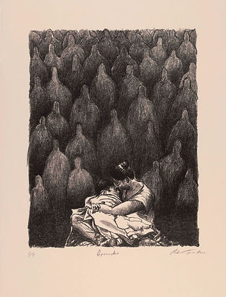
Roberto Torres Matta
Through my work, I direct attention to these complex issues within the scope of displacement. To de-stigmatize migration, I take a multimedia approach realized through the metaphors as symbols and icons to identify historical precedent. The work embodies an emotional sense of realities of human displacement as well as the routes animals depend on for long-distance movement for survival.

Slide 13
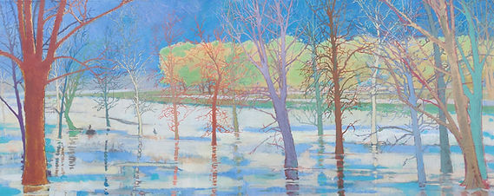
DAVID sEAR
In response to this exhibition’s theme, an image that strikes me the most is the sense of being surrounded by dead trees. A neighbor first brought this to my attention when he asked if I noticed all the dead trees in SE Wisconsin.
Luminescent Trees” is part of a series of works exploring this idea, creating this work on location in the Norris Geyser Basin, in Yellowstone National Park in 2020. It is more of a direct study of wildfire smoke.

Slide 14
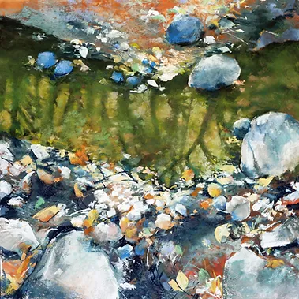
The driving force behind this work is my interest in finding and amplifying the beauty and mystery that exists quietly all around us.
Colette Odya Smith

Slide 15
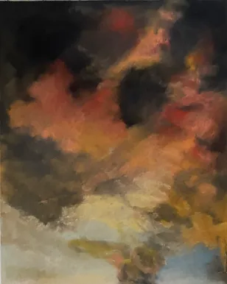
Jan Mirenda Smith
My recent work evolved during the early stages of the pandemic. The world was not only confronted with a deadly virus, but our days were consumed by extraordinary events. The Storming Series emerged using dramatic landscapes from photos I have taken to create pastel and watercolor images that wrestled with the changing atmospheric conditions of our time through climate change.

Slide 16
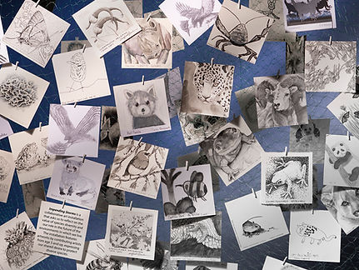
Tori Tasch
The purpose in creating this art installation is to put a spotlight on the reality of the impending dangers of significant loss of species and biodiversity, and by inference, the dangers looming over our biosphere.

Slide 17
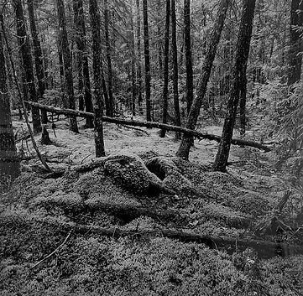
Tom Uttech
His work is inspired by the woods of Northern Wisconsin and the Quetico Provincial Park in Ontario, Canada, where the lakes, forests, and wildlife are untouched by humans. His devotion to nature is apparent in each piece, recreating what it feels like to be in those woods at dawn and dusk when the mystical characters come to life.

Slide 18
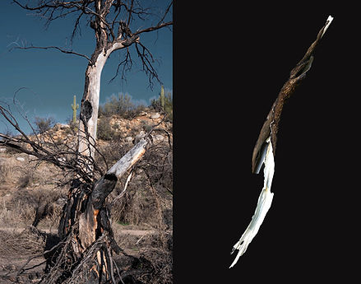
Rina Yoon
Extreme heat, high wind, years of drought. From California coast to the southwest, the country is on fire. In the past ten years, hundreds of thousands of acres have burnt and are burning. In June 2020, I spent a month in Tucson, Arizona during the Bighorn fire. I revisited two years later. Charred, naked, hollowed, the trees remain standing, as if they are there to tell us what they witnessed, hanging onto the memory.

Slide 19
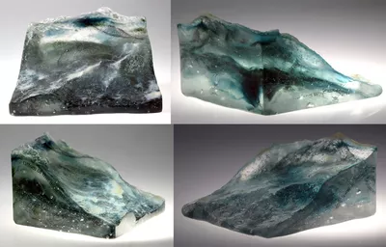
Kristin Thielking

Slide 20
This is an interdisciplinary project utilizing the capture and rendering of 3D-models of ocean waves through photogrammetric processes and the subsequent production of the wave models into fused glassworks illustrating contemporary research in topics relating to ocean health that will be used for scientific and environmental education.
Its innovative application facilitates the scientific outreach mission, and its potential to open new avenues for artists.

Slide 21
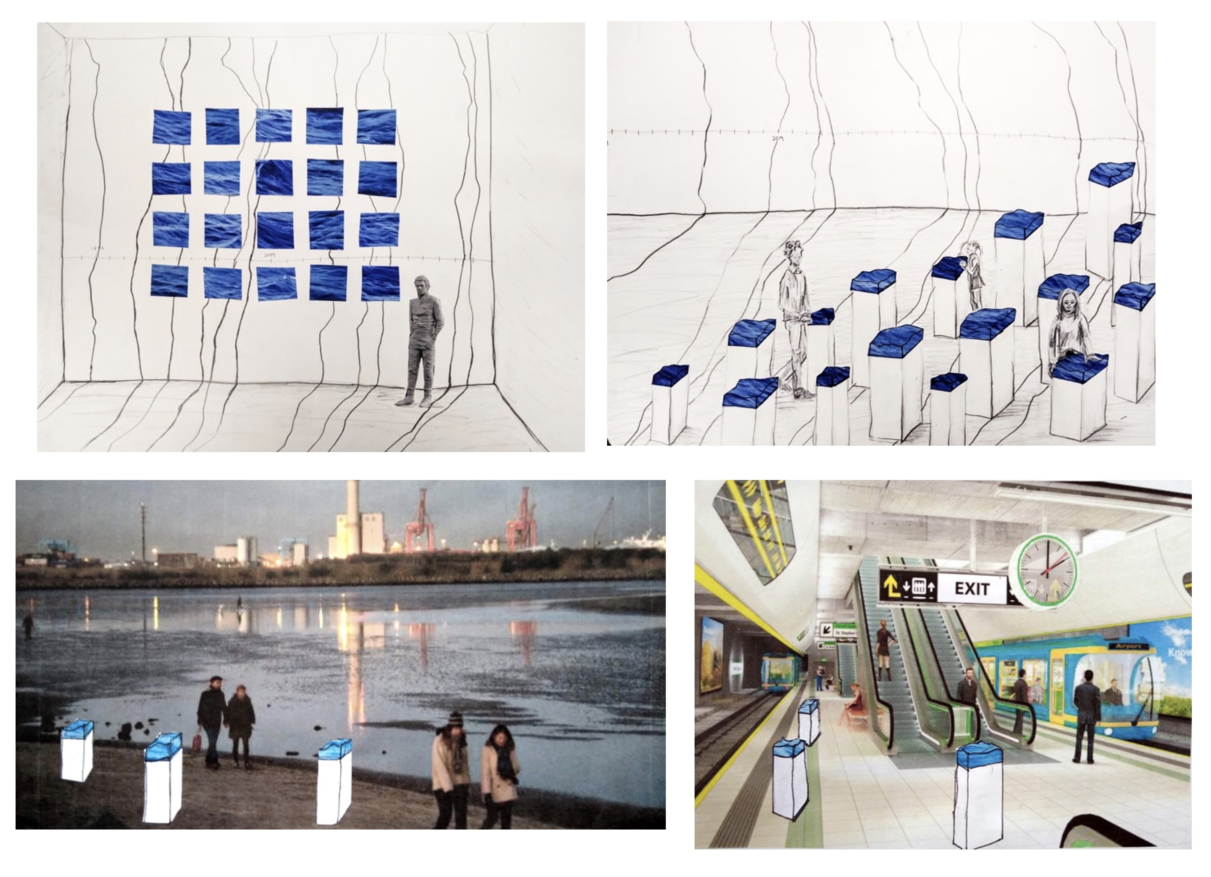

Slide 22
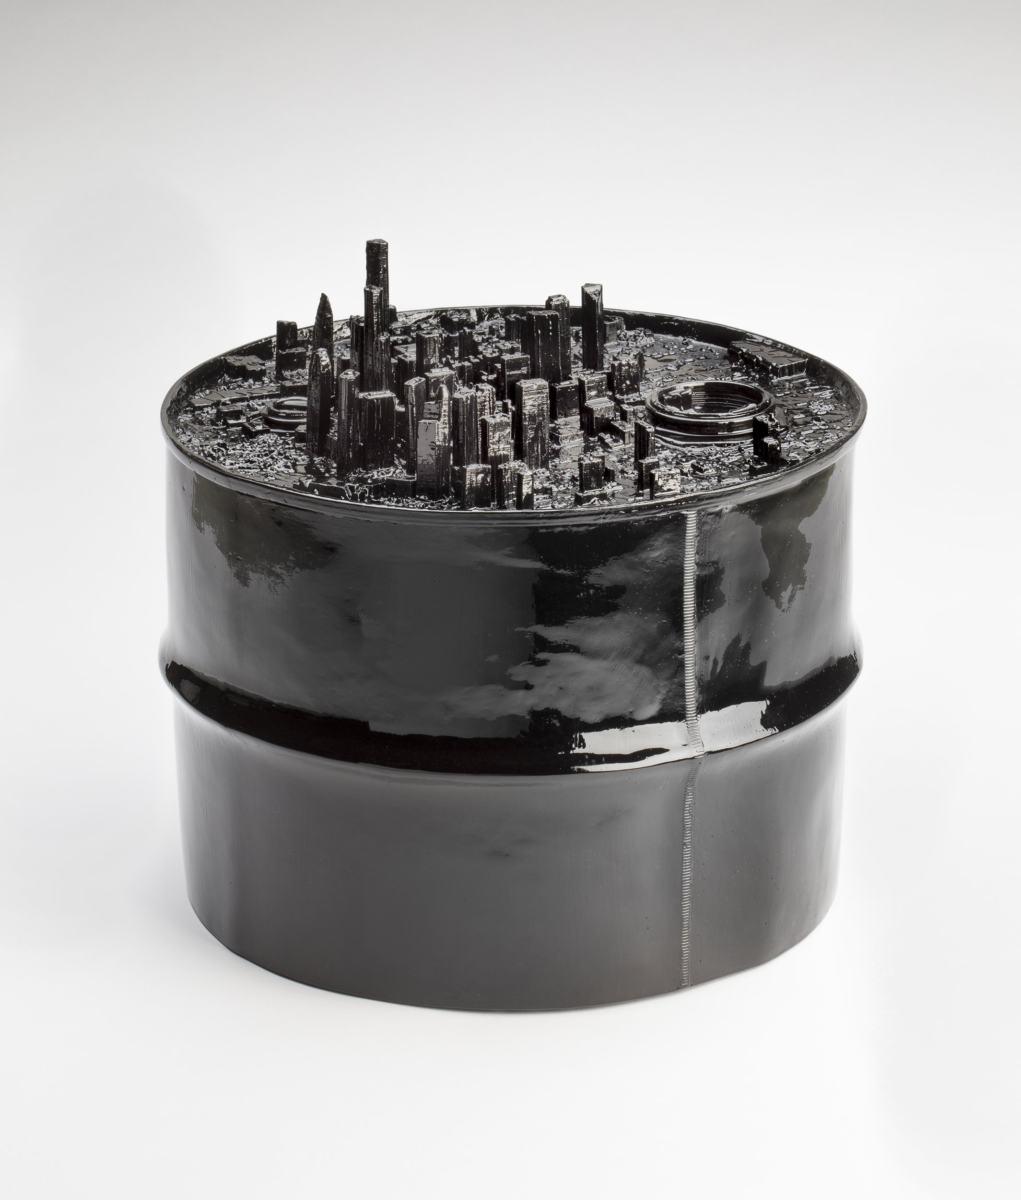
Norwood Viviano

Slide 23
Norwood Viviano
Norwood Viviano’s work is about change.
Conversations with specialists in a range of disciplines — historians, urban planners, demographers, climate scientists and statisticians — deepen my engagement with the subject matter and the complexity of my work.

Slide 24
OlafUr Eliasson
For Ice Watch, Eliasson and geologist Minik Rosing brought free-floating icebergs from a fjord outside Nuuk, Greenland, to public squares in European cities (Copenhagen, 2014; Paris, 2015; and London, 2018) to raise awareness of the climate crisis.
Every glacier lost reflects our inaction. Every glacier saved will be a testament to the action taken in the face of the climate emergency. One day, instead of mourning the loss of more glaciers, we must be able to celebrate their survival.
Solar energy 2022

Slide 25
Olafur Eliasson
Glacier melt series

Slide 26
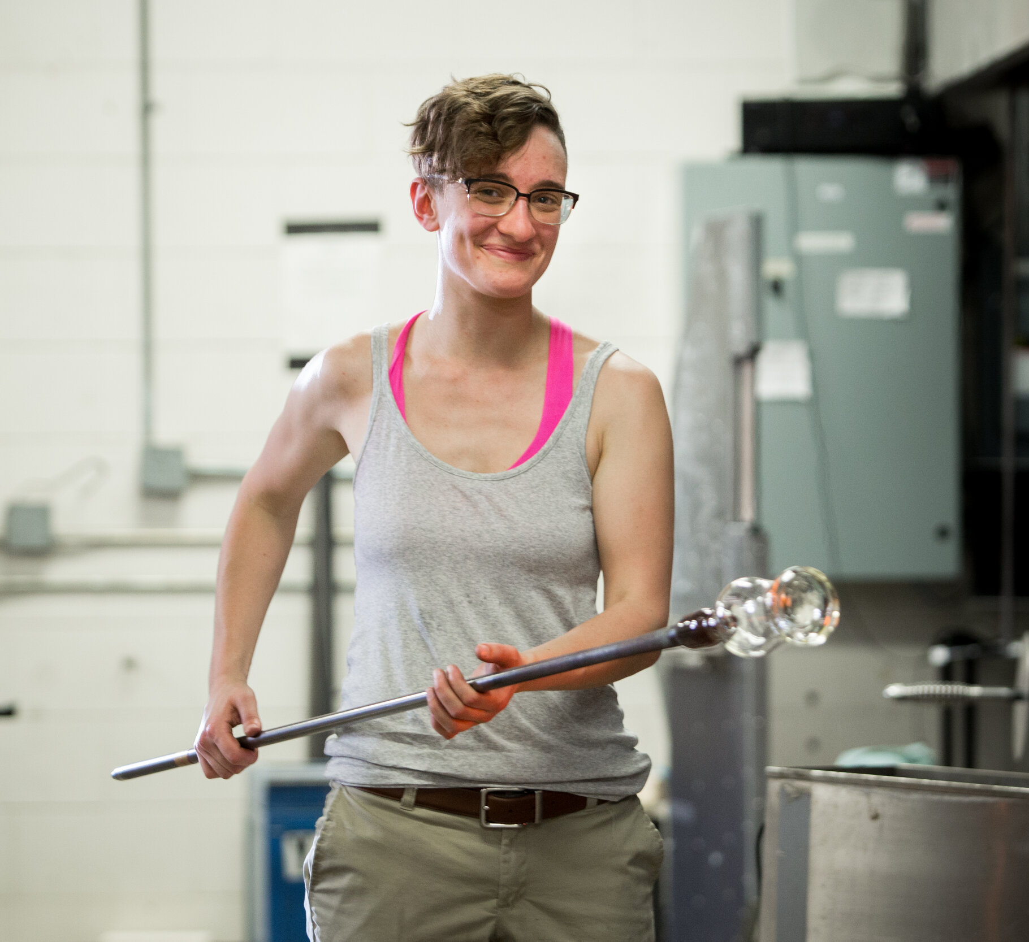
Anna Lehner
https://www.facebook.com/watch/?v=920101615060679

